Slide 1
Guidelines & Discount Codes
Games Group

Slide 2
Weekly “chill” game nights
Maximum $40 budget for snacks and soft drinks for groups up 10 people
  No alcohol (different rules/forms/etc. through student life)
For groups greater than 10, snack budget increased by $5 per person
Food & Drinks
All weekly game nights will mention the game(s) or types of games that will be played
Offer variety of game types/games and also have a few video game nights per quarter
Offer game nights different nights of the week (not just one day)
Variety & Accessibility
Each games co-chair will host at least one
At least one event per week (can skip small group game night the weeks we have larger events if needed)
Co-Chair Duties

Slide 3
Chill game nights
Registration opens three weeks before the event and closes 10pm the day before the event
Registration can be cancelled up to three days before the event
Ticket is $5; refunded to members after the event

Slide 4
Escape Rooms at Escape Game Chicago
The Escape Game contact:
Caro Scarbrough: Caro.Scarbrough@theescapegame.com
Historically given rates of $26/person during weekdays before 5pm
  charge $15 for members, $30 for non-members
6 people to reserve a room but we’ve been able to get away with booking fewer per room and taking the risk no one else will book because they’re odd times

Slide 5
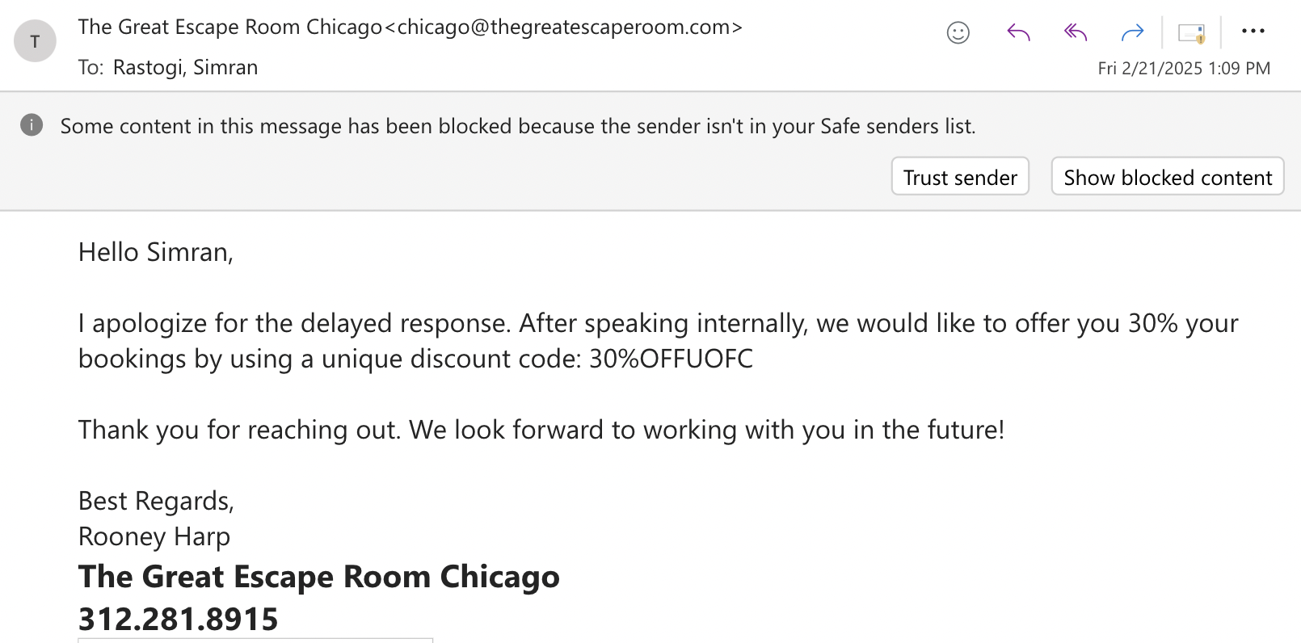
Escape Room at Great Escape Chicago

Slide 6
Escape Rooms at PanIQ Chicago
https://paniqescaperoom.com/chicago/en/escape-rooms#fulton-market
20% discount code (normally)
If you pre-buy the room after you finish an escape room there, they’ll give you an on-the-spot 30% discount

